Slide 1
DEPARTMENT OF COMPUTER SCIENCE
Msc. in computer science
Computer Vision (MSC 7224)
Final Project: Herbal plant detection and recognition
Name | RegNo | StdNo
Lebuga Bosco | 2024/HD05/25333U | 2400725333
https://huggingface.co/spaces/Lebuga/herbal-plant-detector : deployment link

Slide 2
INTRODUCTION
Computer Vision Challenges
Motivation
Herbal plants play an important role in medicine, agriculture, and biodiversity conservation.
Manual plant identification requires expert knowledge and is time-consuming.
Misidentification of medicinal plants can lead to incorrect usage and potential health risks.
Automated detection systems can improve accuracy, efficiency, and accessibility.
High visual similarity among different herbal plant species.
Variations in lighting, shadows, and weather conditions.
Complex backgrounds and surrounding vegetation.
Partial occlusion of leaves, stems, and plant structures.
Different camera angles, distances, and image quality.
Limited availability of annotated herbal plant datasets.

Slide 3
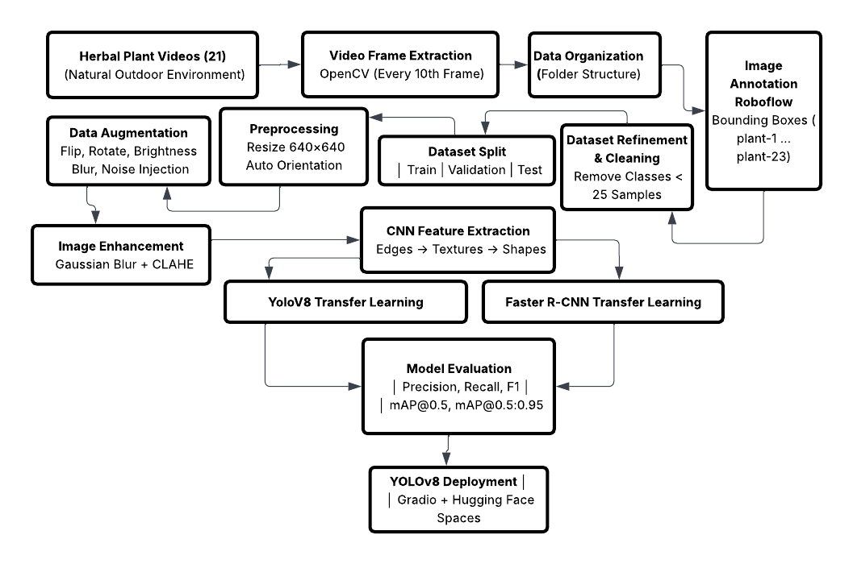
METHODOLOGY

Slide 4
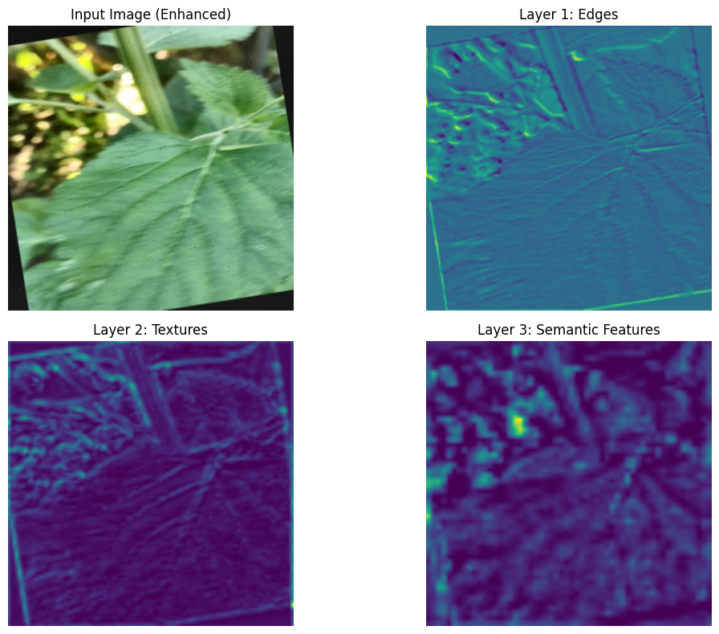
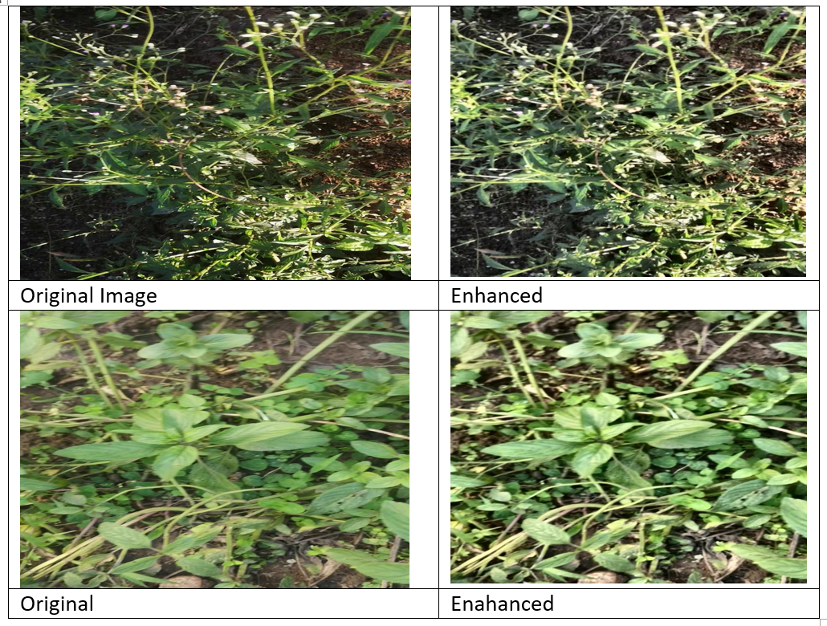
RESULTS AND ANALYSIS
Samples of herbal plant images before and after image enhancement
Image extraction performed using CNNs

Slide 5
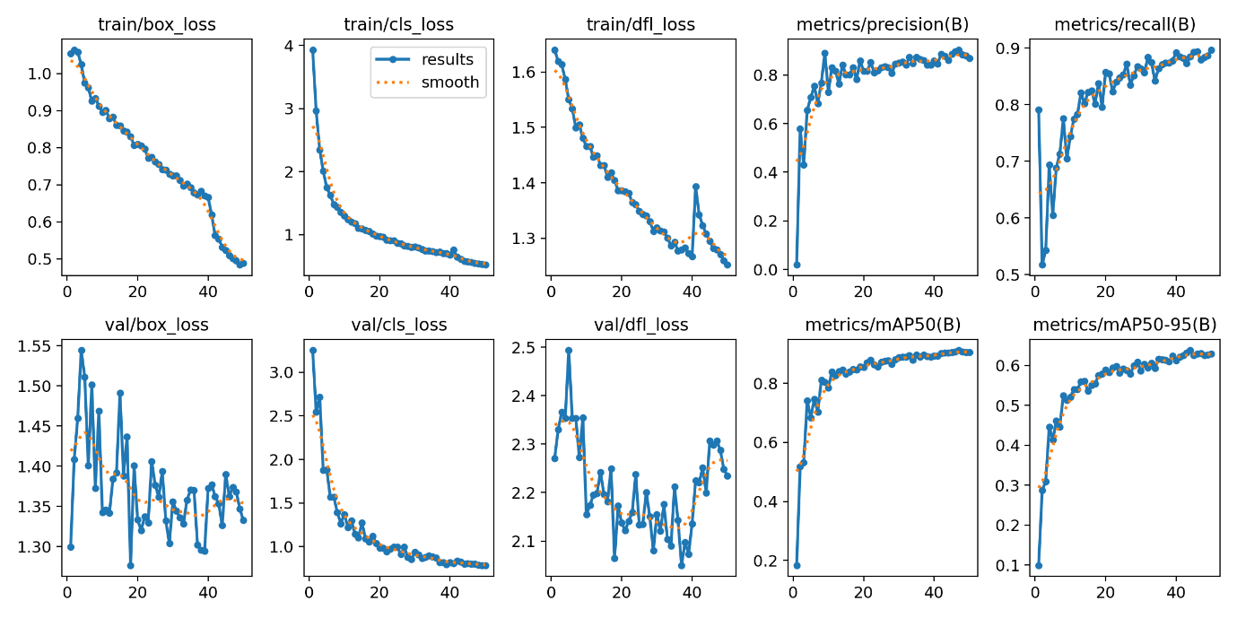
RESULTS AND ANALYSIS
Training performance curves
Overall performance Yolov8
Metric | Value
Precision | 0.8600423505381747
Recall | 0.8848941989838961
mAP@0.5 | 0.9026508411087439
mAP@0.5:0.95 | 0.6387935006641632

Slide 6
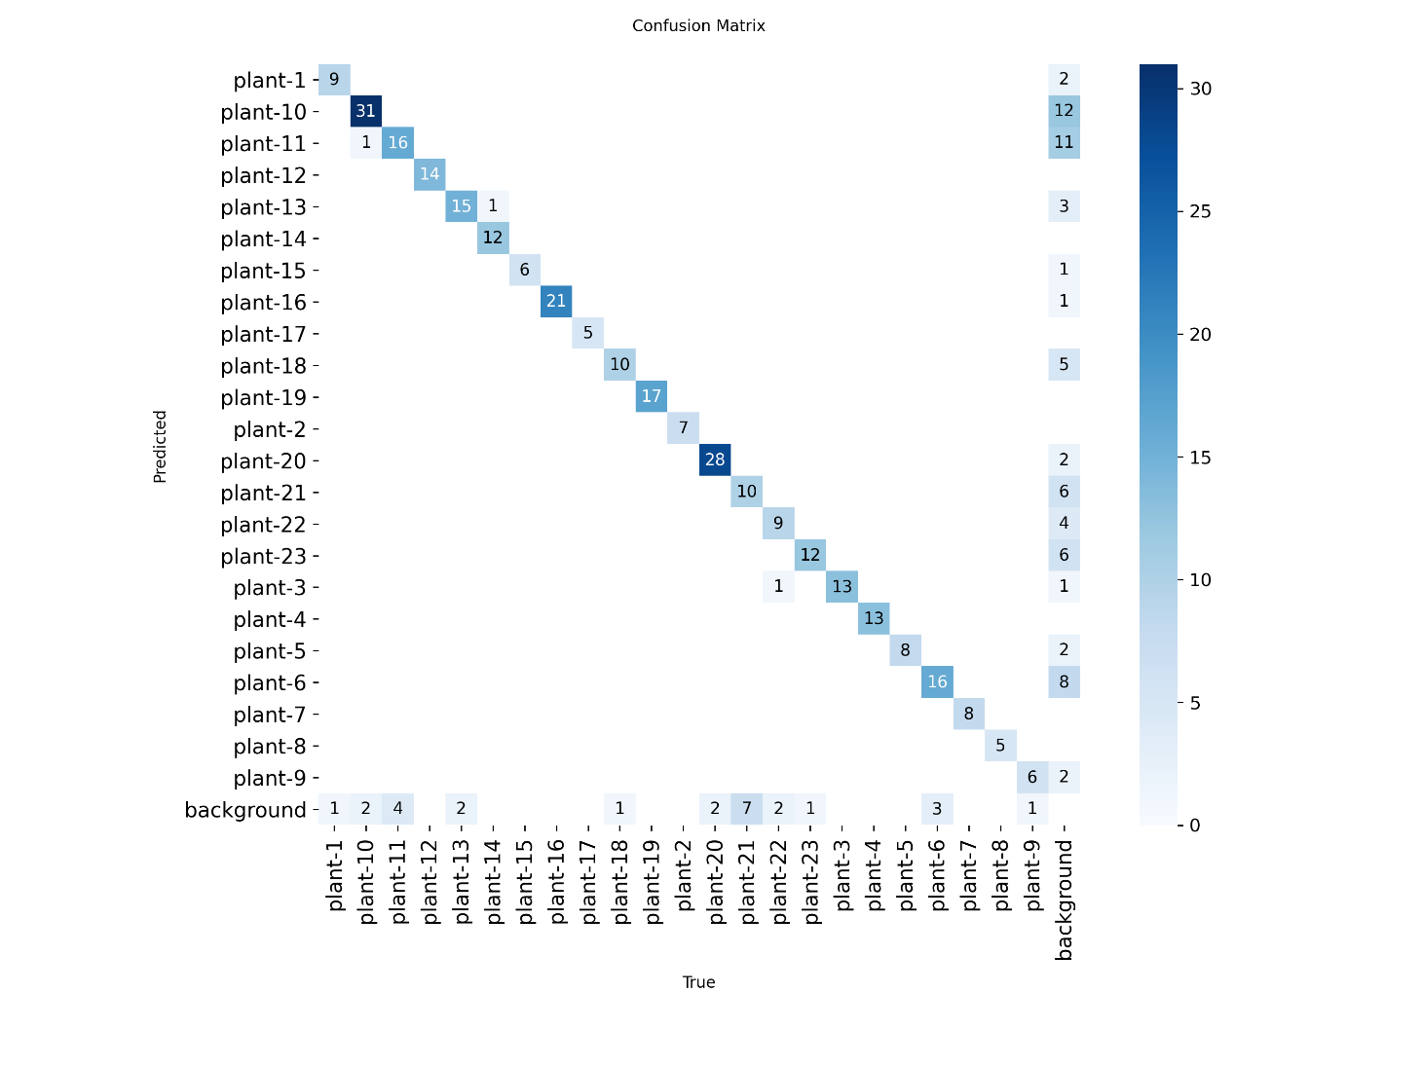
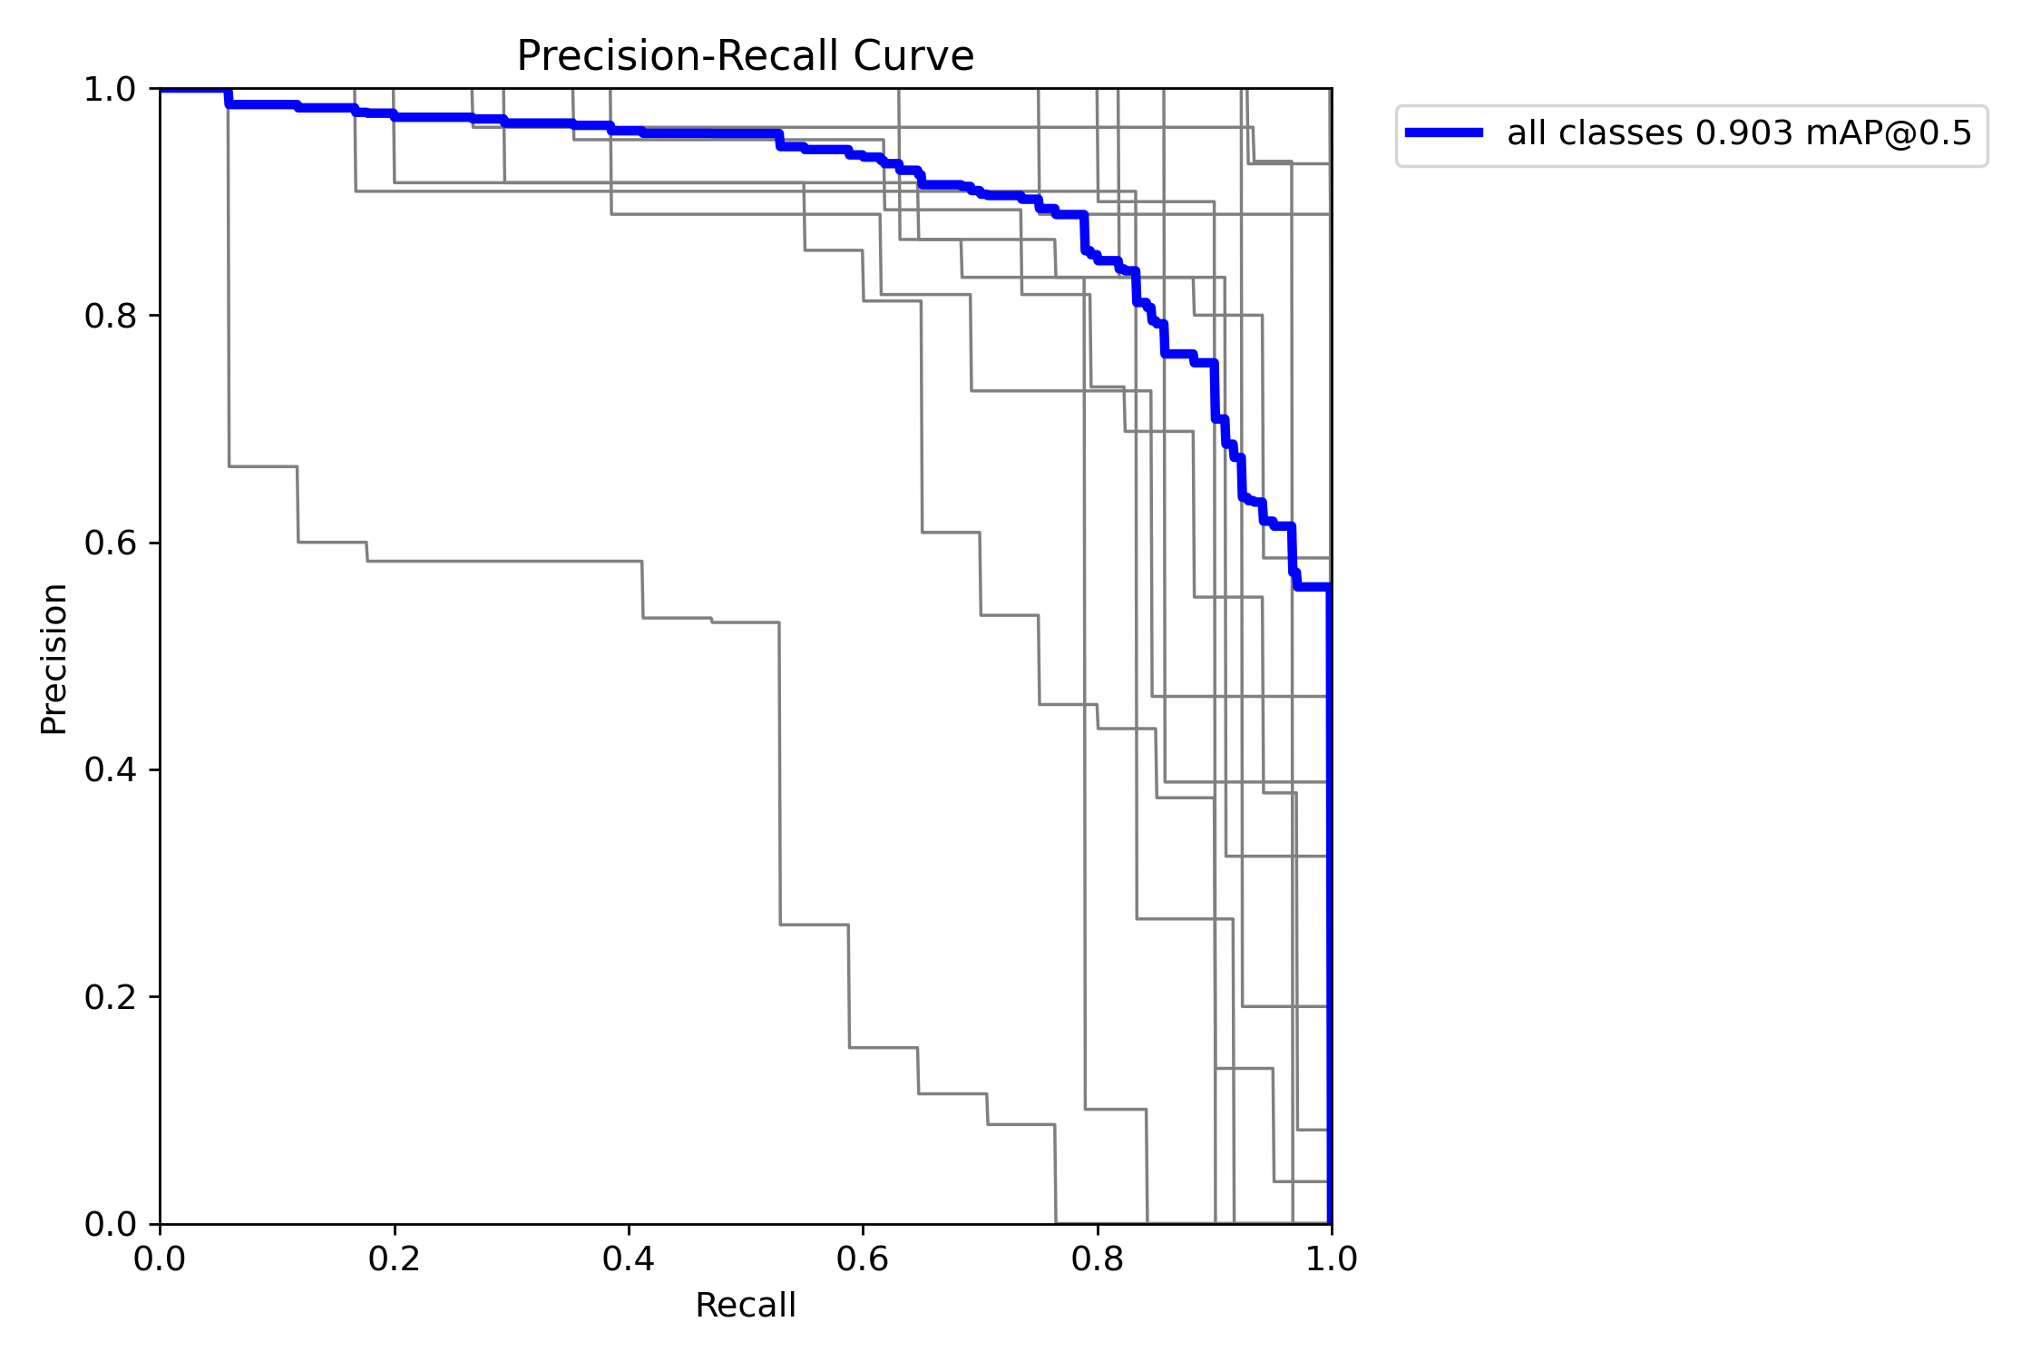
RESULTS AND ANALYSIS

Slide 7
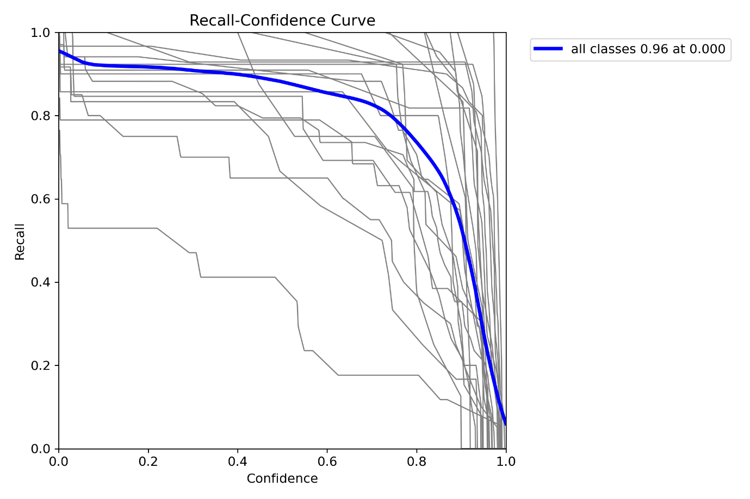
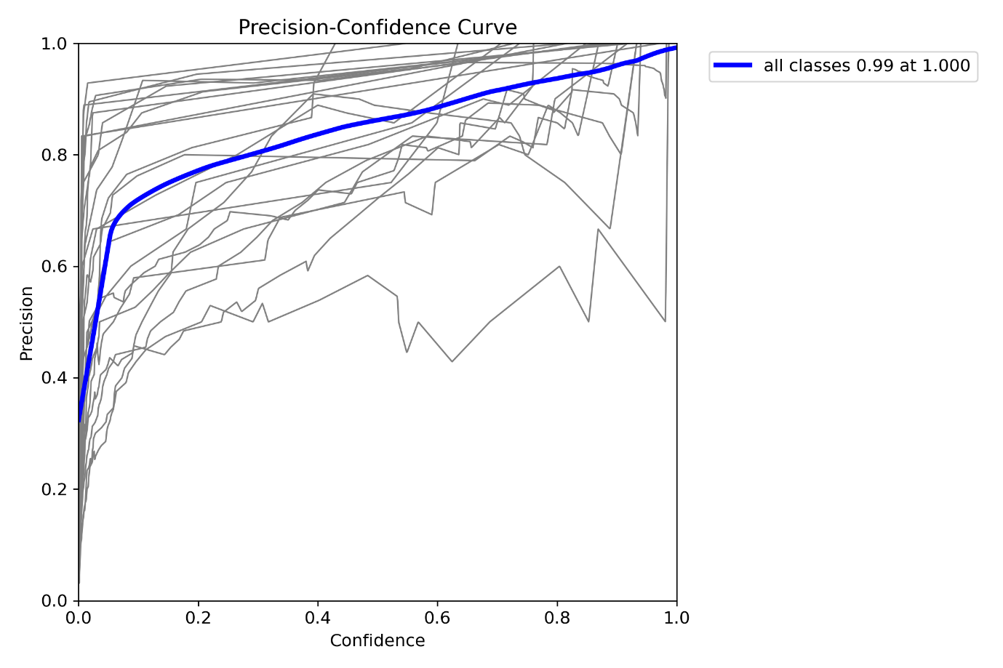
RESULTS AND ANALYSIS

Slide 8
RESULTS AND ANALYSIS
Overall Performance Faster R-CNN
Model Comparison
Metric | Value
Precision | 0.3440860178055267
Recall | 0.969696940312214
F1 Score | 0.5079361132529994
Metric | Yolov8 | Faster R-CNN
Precision | 0.8600 | 0.3441
Recall | 0.8849 | 0.9697
mAP@0.5 | 0.9027 | -
mAP@0.5:0.95 | 0.6388 | -
F1 Score | - | 0.5079

Slide 9
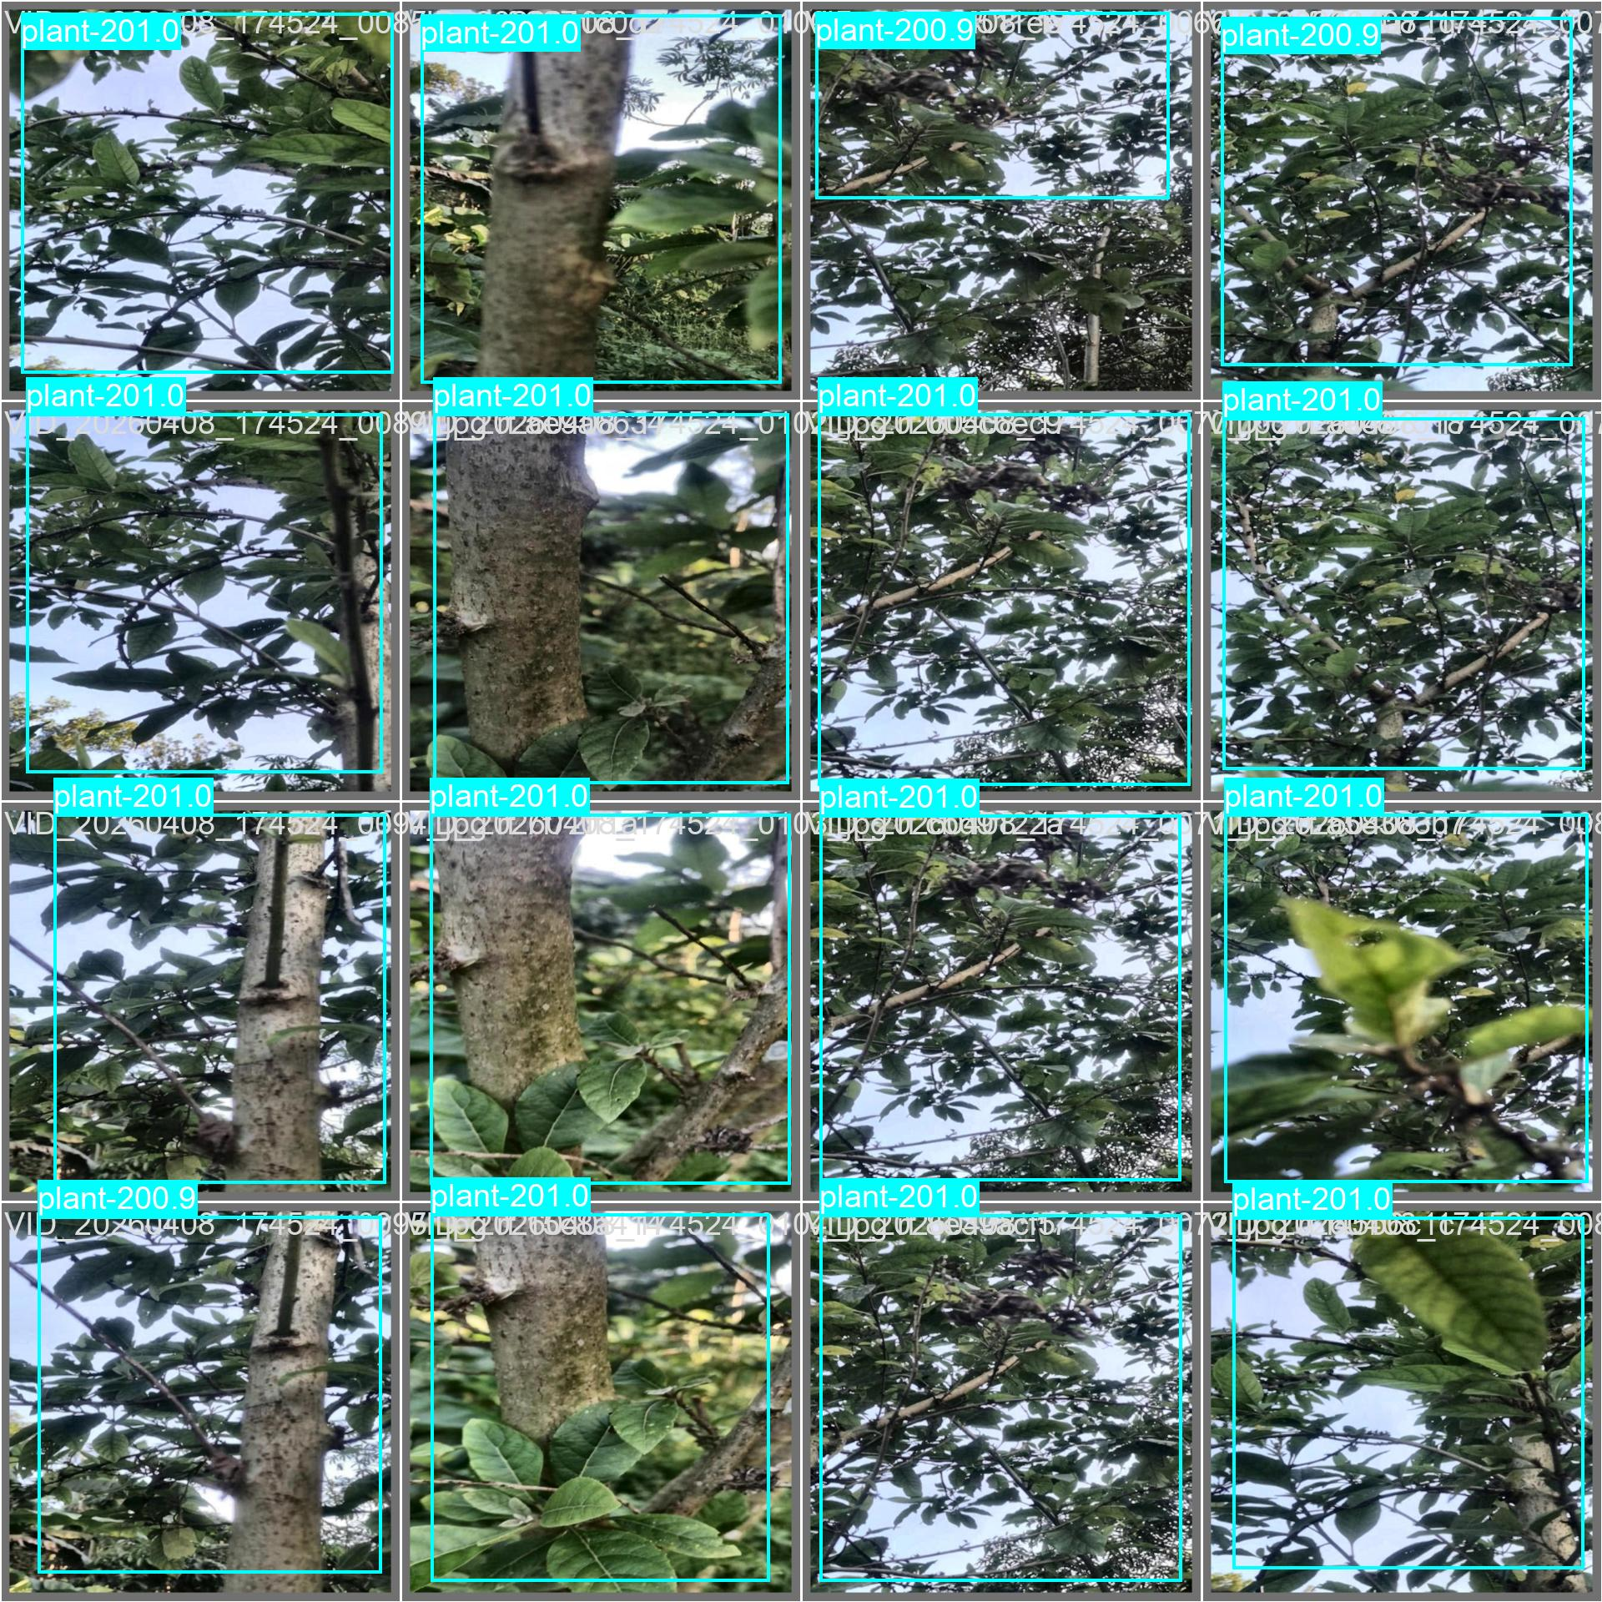
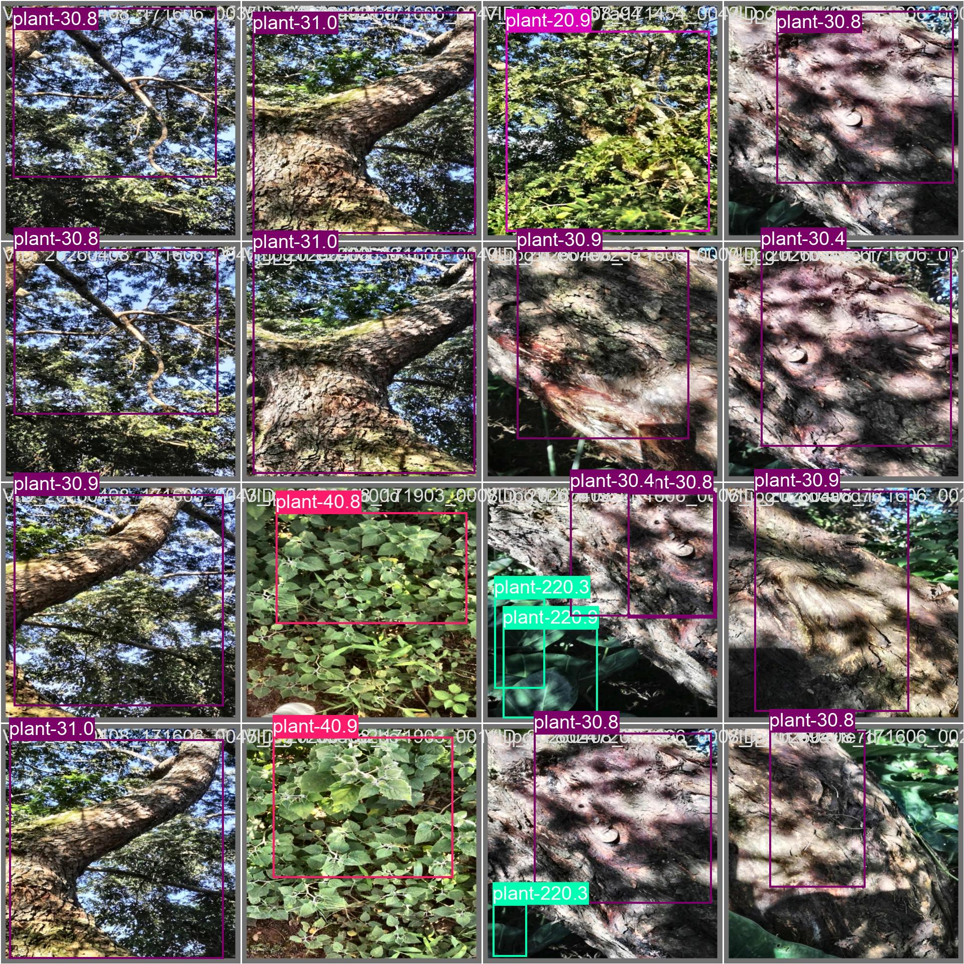
RESULTS AND ANALYSIS
Yolov8 Validation Batch 0 Predictions
Validation Batch 1 Prediction Results

Slide 10
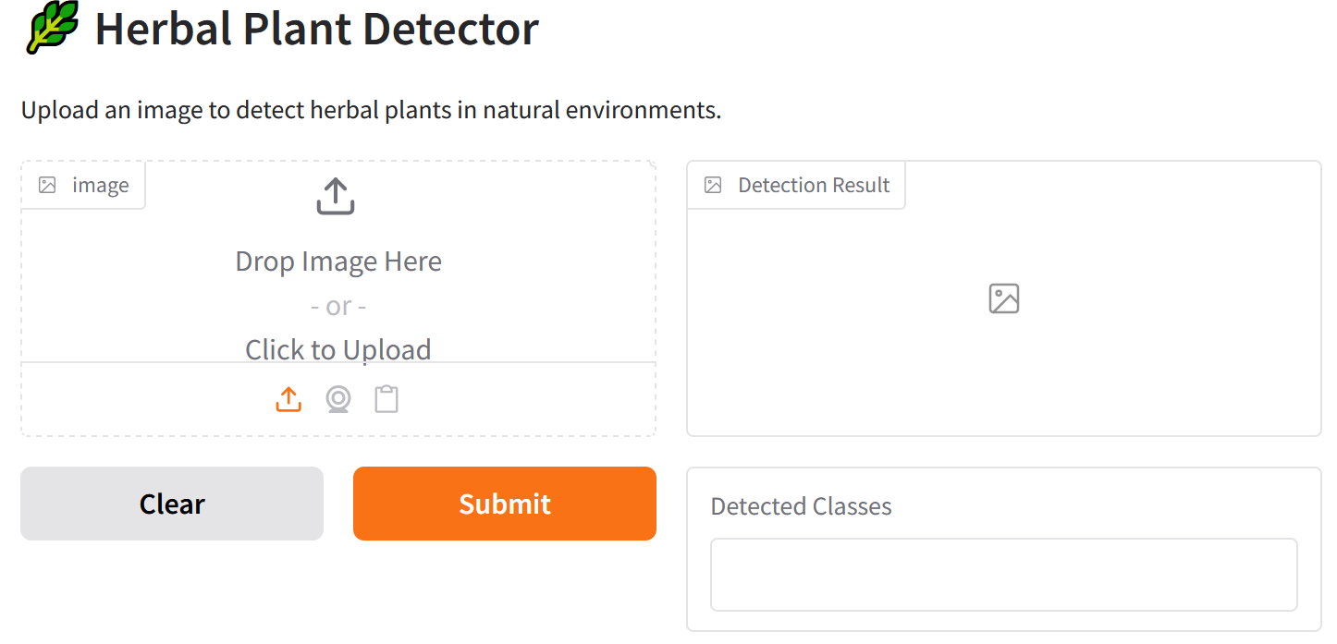
RESULTS AND ANALYSIS
Deplpyed model User Interface

Slide 11
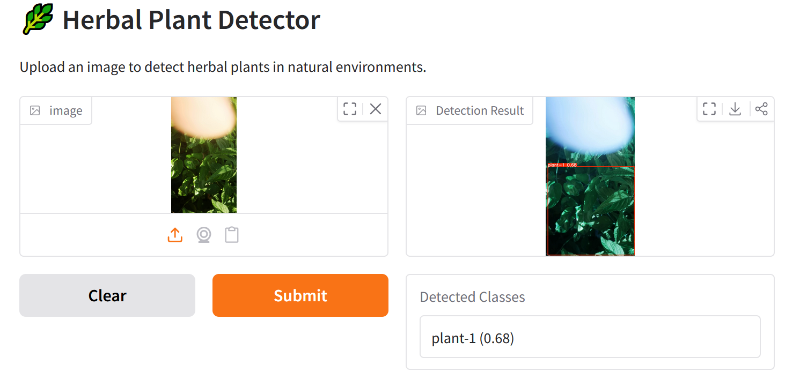
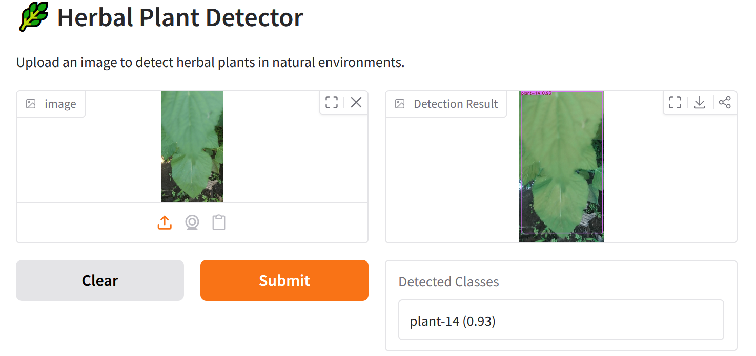
RESULTS AND ANALYSIS
Deplpyed model User Interface

Slide 12
Conlcusions, recommendations and future work
Conclusion
This study successfully developed an intelligent deep learning framework for herbal plant detection in natural environments using image enhancement techniques and the YOLOv8 object detection model.
The proposed framework effectively achievied strong detection performance with a precision of 86.00%, recall of 88.49%, mAP@0.5 of 90.27%, and mAP@0.5:0.95 of 63.88%.
Validation results demonstrated accurate localization and classification of multiple herbal plant species under varying environmental conditions,
Recommendations
The developed YOLOv8-based herbal plant detection system be adopted as a supporting tool for herbal plant identification in Furthermore, the framework should be deployed through mobile or web-based applications to enable real-time field identification and promote practical use
Future Work
improving the technical capabilities of the proposed framework by investigating advanced deep learning architectures, such as attention-based and transformer-based object detection models.
Additional studies should explore methods for detecting small, partially occluded, and visually similar plant species, as well as integrating multimodal data sources such as spectral imagery and plant morphological features.

